Slide 1
Microsoft Power BI

Slide 2
Modern React-JS Development with Power BI Embedding
Ted Pattison
Principal Program Manager
Power BI Customer Advisory Team (PBICAT)

Slide 3
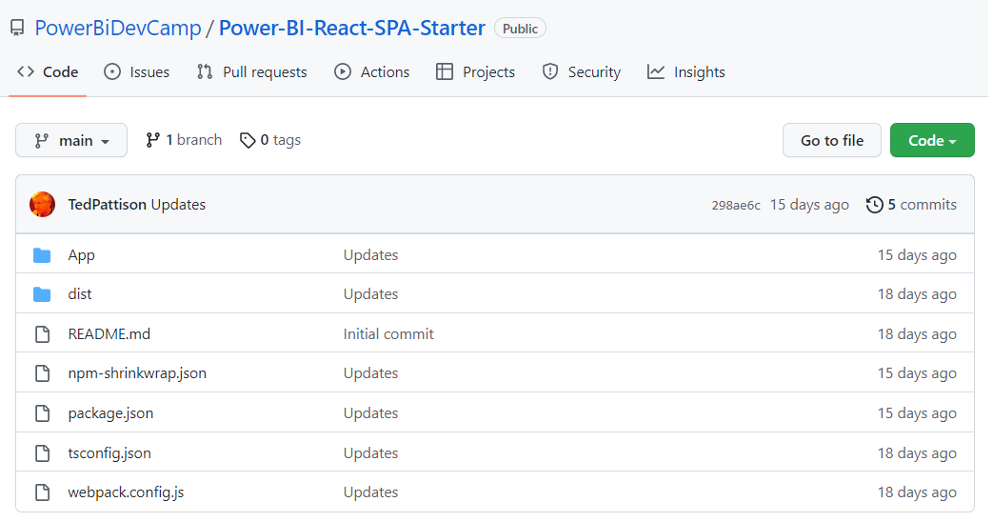
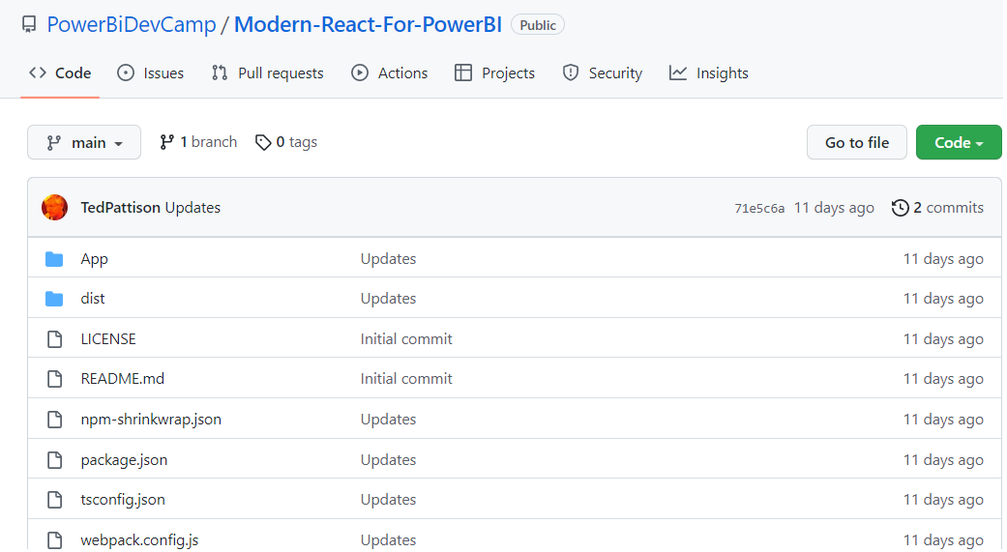
Developer Samples used in This Session
Power BI React SPA Starter
Sample starter project to SPA development using React, TypeScript, MSAL and Power BI REST API
https://github.com/PowerBiDevCamp/Power-BI-React-SPA-Starter
Modern React for Power BI
Sample project demonstrating development techniques for User-Owns-Data embedding
https://github.com/PowerBiDevCamp/Modern-React-For-PowerBI

Slide 4
Agenda
Modern React Primer
Building a User Interface using Material UI
Authenticating Users with MSAL
Calling the Power BI REST API
Managing Application State using Context
Implementing User-Owns-Data Embedding

Slide 5
Modern React – Essential Concepts
What’s wrong with the classic React programming model?
Class-based components and lifecycle methods adds complexity even in simple scenarios
Easy to introduce bugs when implementing lifecycle methods
Moving to the modern React-JS programming model
Functional components replace class-based components
Hooks replace classic React state management and lifecycle methods
Class React with Class-based Components
Modern React with Functional Components

Slide 6
Hooks – a few quick examples
Hooks provided by React demonstrated in this session
useState
useEffect
useLayoutEffect
useRef
useNavigate
useContext
Hooks provided by Microsoft Authentication Library for React
useIsAuthenticated
useMsal
useAccount

Slide 7
Getting Started with Hooks - useState
Component state tracked using useState hook
Only call hooks like useState at the top level of your components – do not nest these calls!
useState returns array with state value (message) and state modifier method (setMessage)
State value (message) can be used anywhere in component
Calling state modifier method (setMessage) in event handler triggers re-render
Calling state modifier method (setMessage) during rendering causes recursion – don’t do it!

Slide 8
Writing Pure Functions without Side Effects
Functional components should be written as pure functions
Pure function performs a calculation and nothing more
Pure function has no side effects – it never updates state, props or context
Pure function always return the same result given same input values
Pure function avoids risk of baffling bugs and unpredictable behavior
Where do you add code which updates data in a functional component?
Inside event handlers
In function wired up using useEffect hook

Slide 9
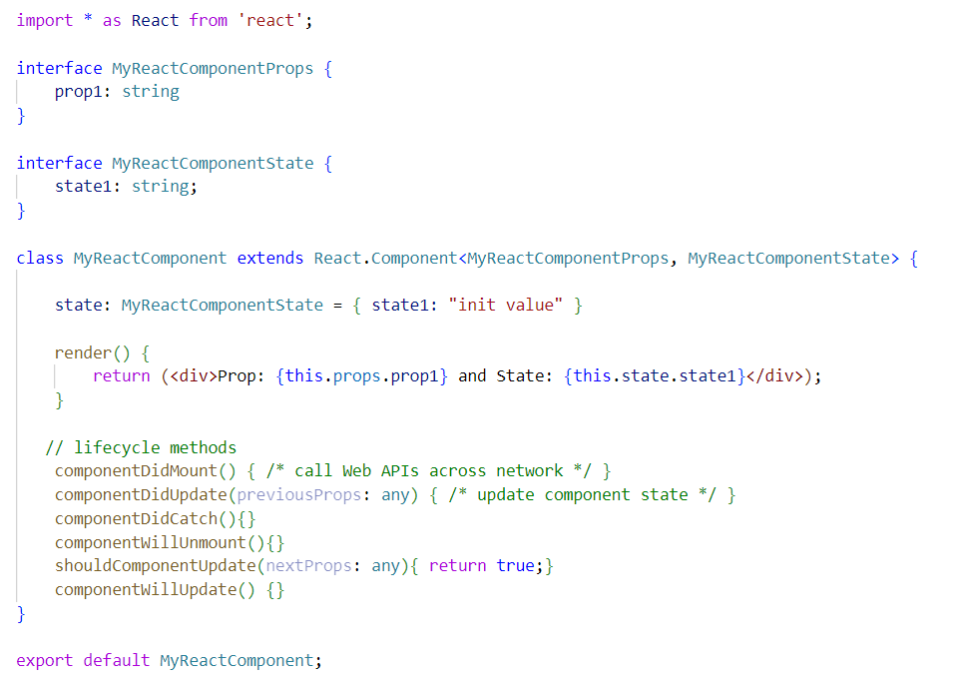
Migrating from Classic React to Modern React
Classic React based on class-based components and lifecycle method
Modern React based on functional components and hooks
Class React with Class-based Components
Modern React with Functional Components

Slide 10
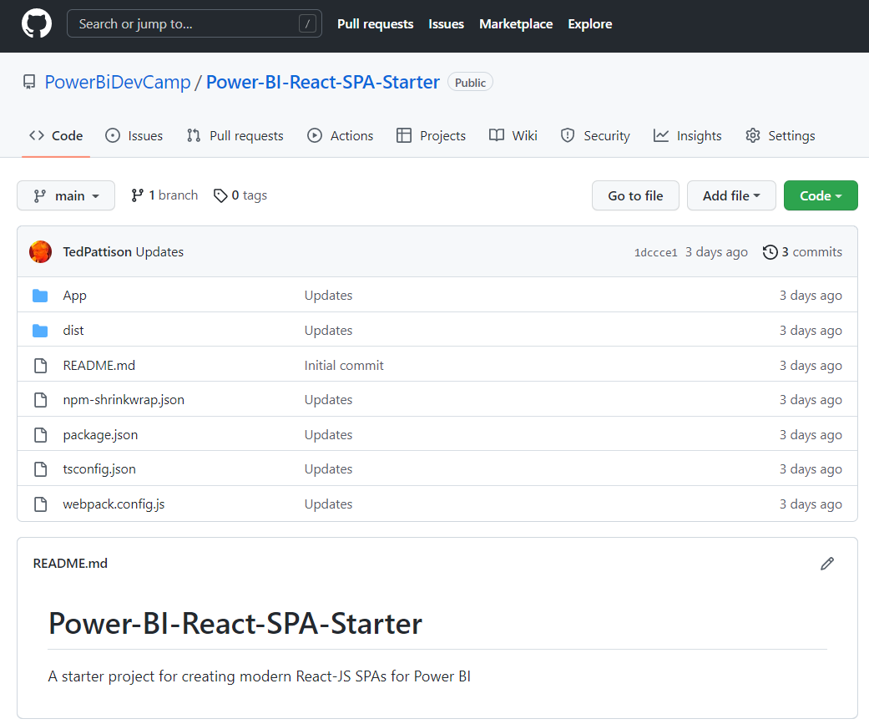
GitHub Repository: Power-BI-React-SPA-Starter
Demo code from this session available in public GitHub repository
https://github.com/PowerBiDevCamp/Power-BI-React-SPA-Starter

Slide 11
Understanding the PowerBI-React-SPA-Starter Project
NPM Package Support
React & React Router
Material UI
MSAL & MSAL React
TypeScript
Webpack

Slide 12
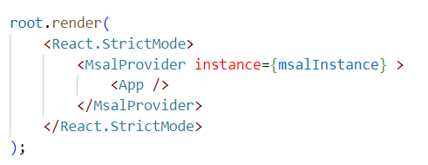
Top-level Component Hierarchy
Support for MSAL, CssBaseline and React Router
index.tsc
app.tsc
pagelayout.tsc

Slide 13
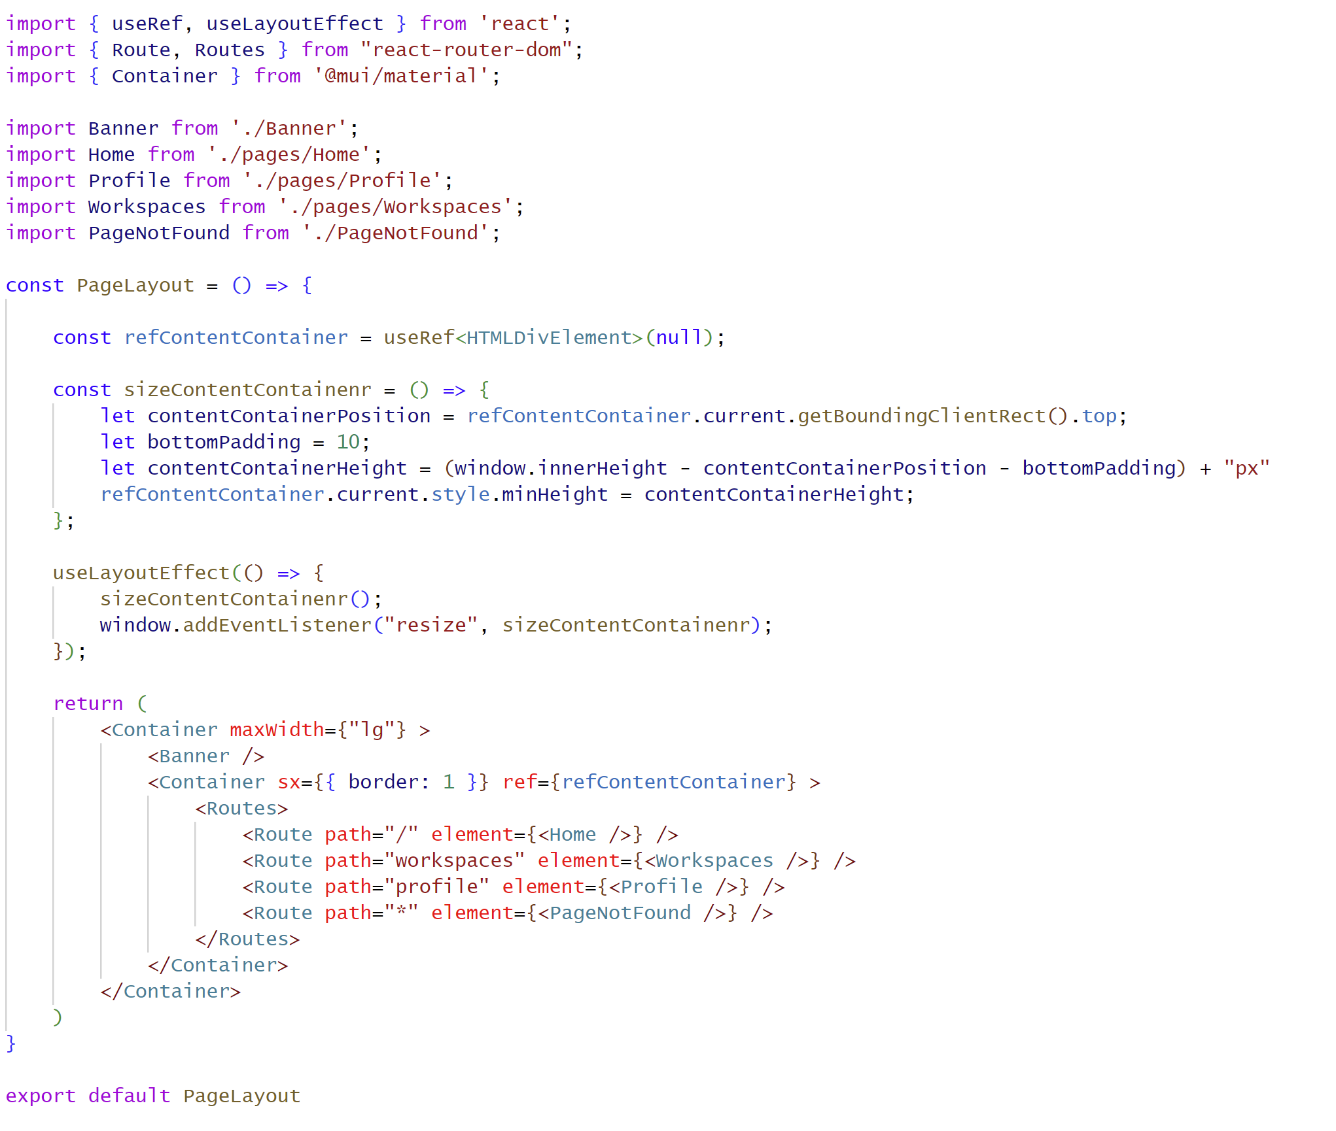
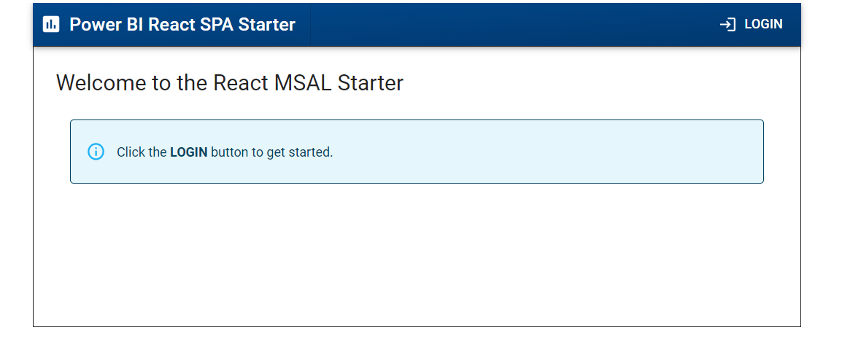
PageLayout.tsx demonstrates useRef and useLayoutEffect
Resize div to take up most of screen

Slide 14
Agenda
Modern React Primer
Building a User Interface using Material UI
Authenticating Users with MSAL
Calling the Power BI REST API
Managing Application State using Context
Implementing User-Owns-Data Embedding

Slide 15
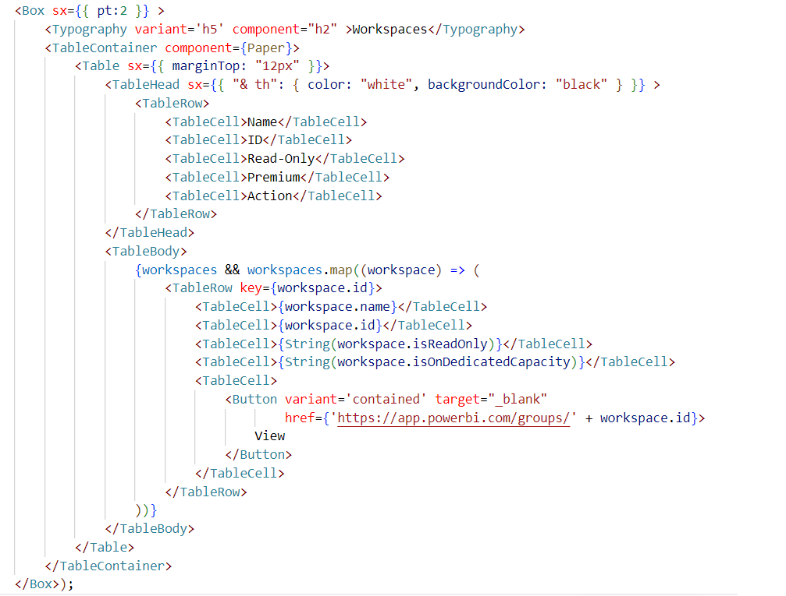
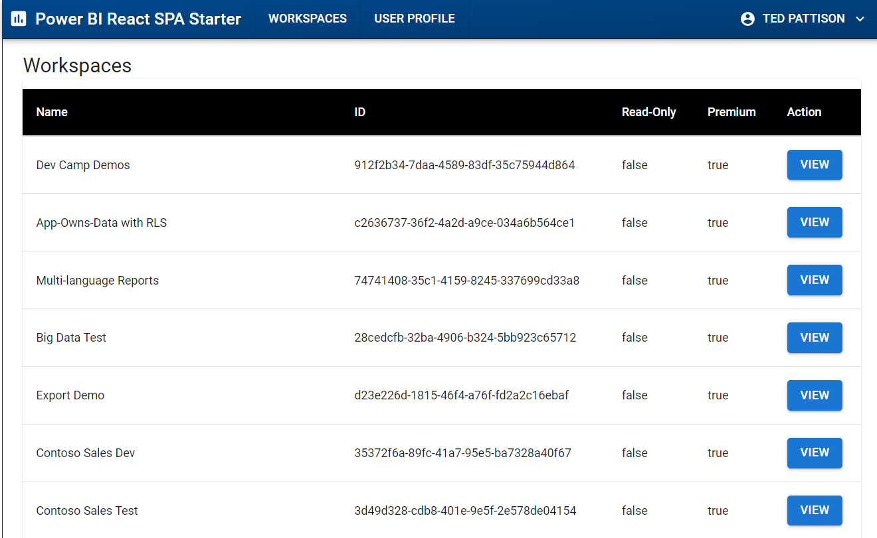
Working with React Components from Material UI
Import Material UI Components
Build UI using Material UI components

Slide 16
Agenda
Modern React Primer
Building a User Interface using Material UI
Authenticating Users with MSAL
Calling the Power BI REST API
Managing Application State using Context

Slide 17
MSAL.js V 2.0
Microsoft Authentication Library for JavaScript
Authenticates SPA users with Azure AD
Install using node.js - npm i @azure/msal-browser
Docs: https://github.com/AzureAD/microsoft-authentication-library-for-js

Slide 18
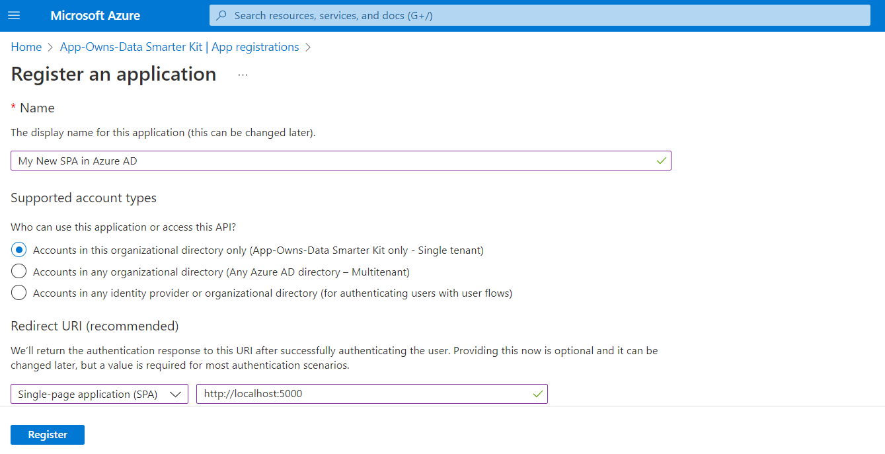
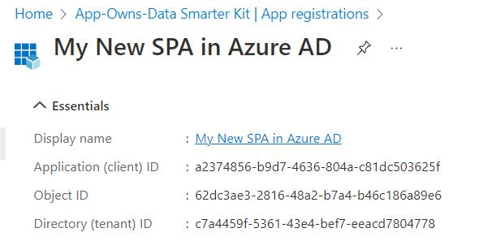
Register Applications as SPA with Azure AD

Slide 19
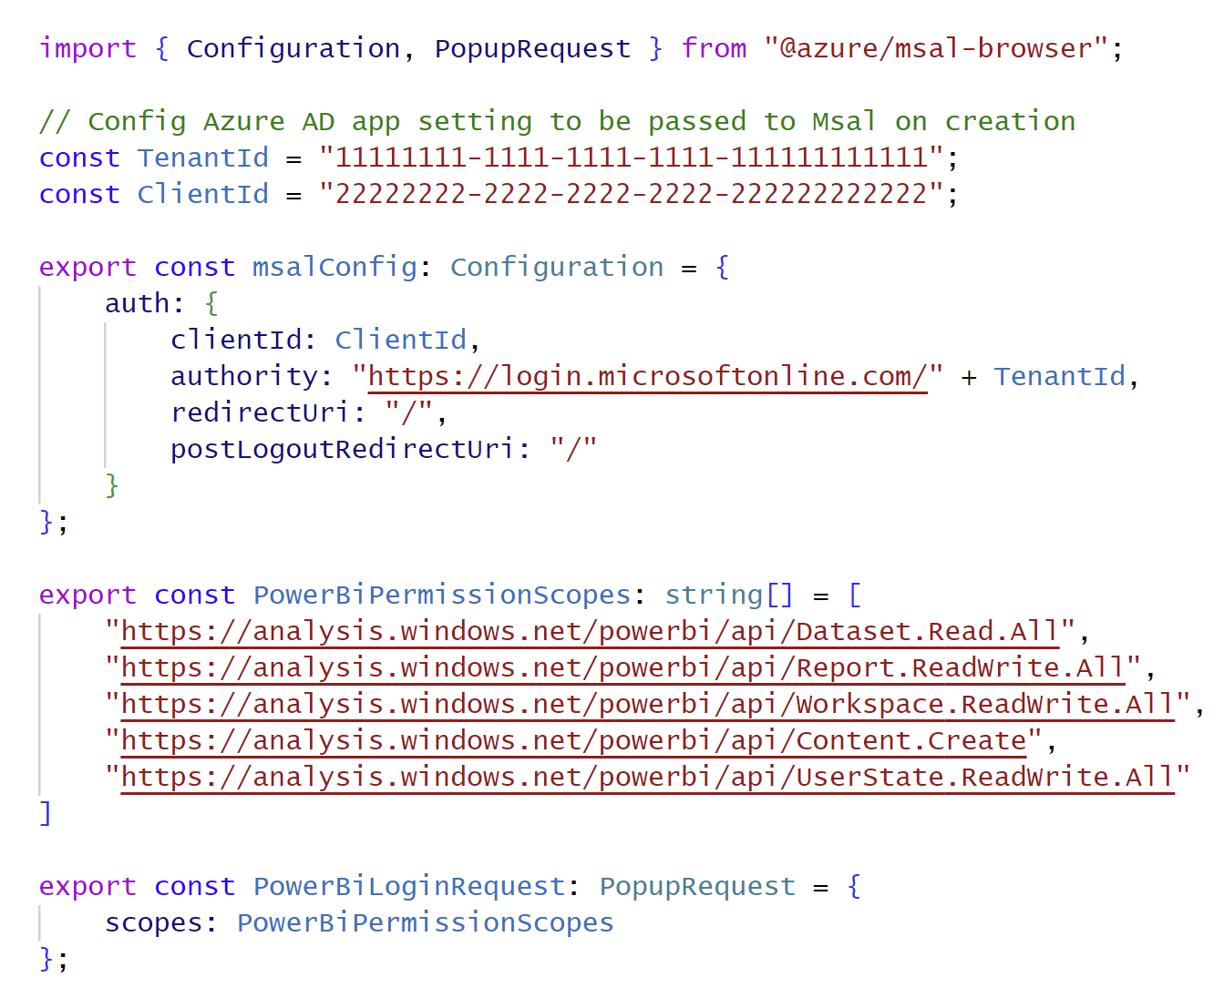
AuthConfig.ts

Slide 20
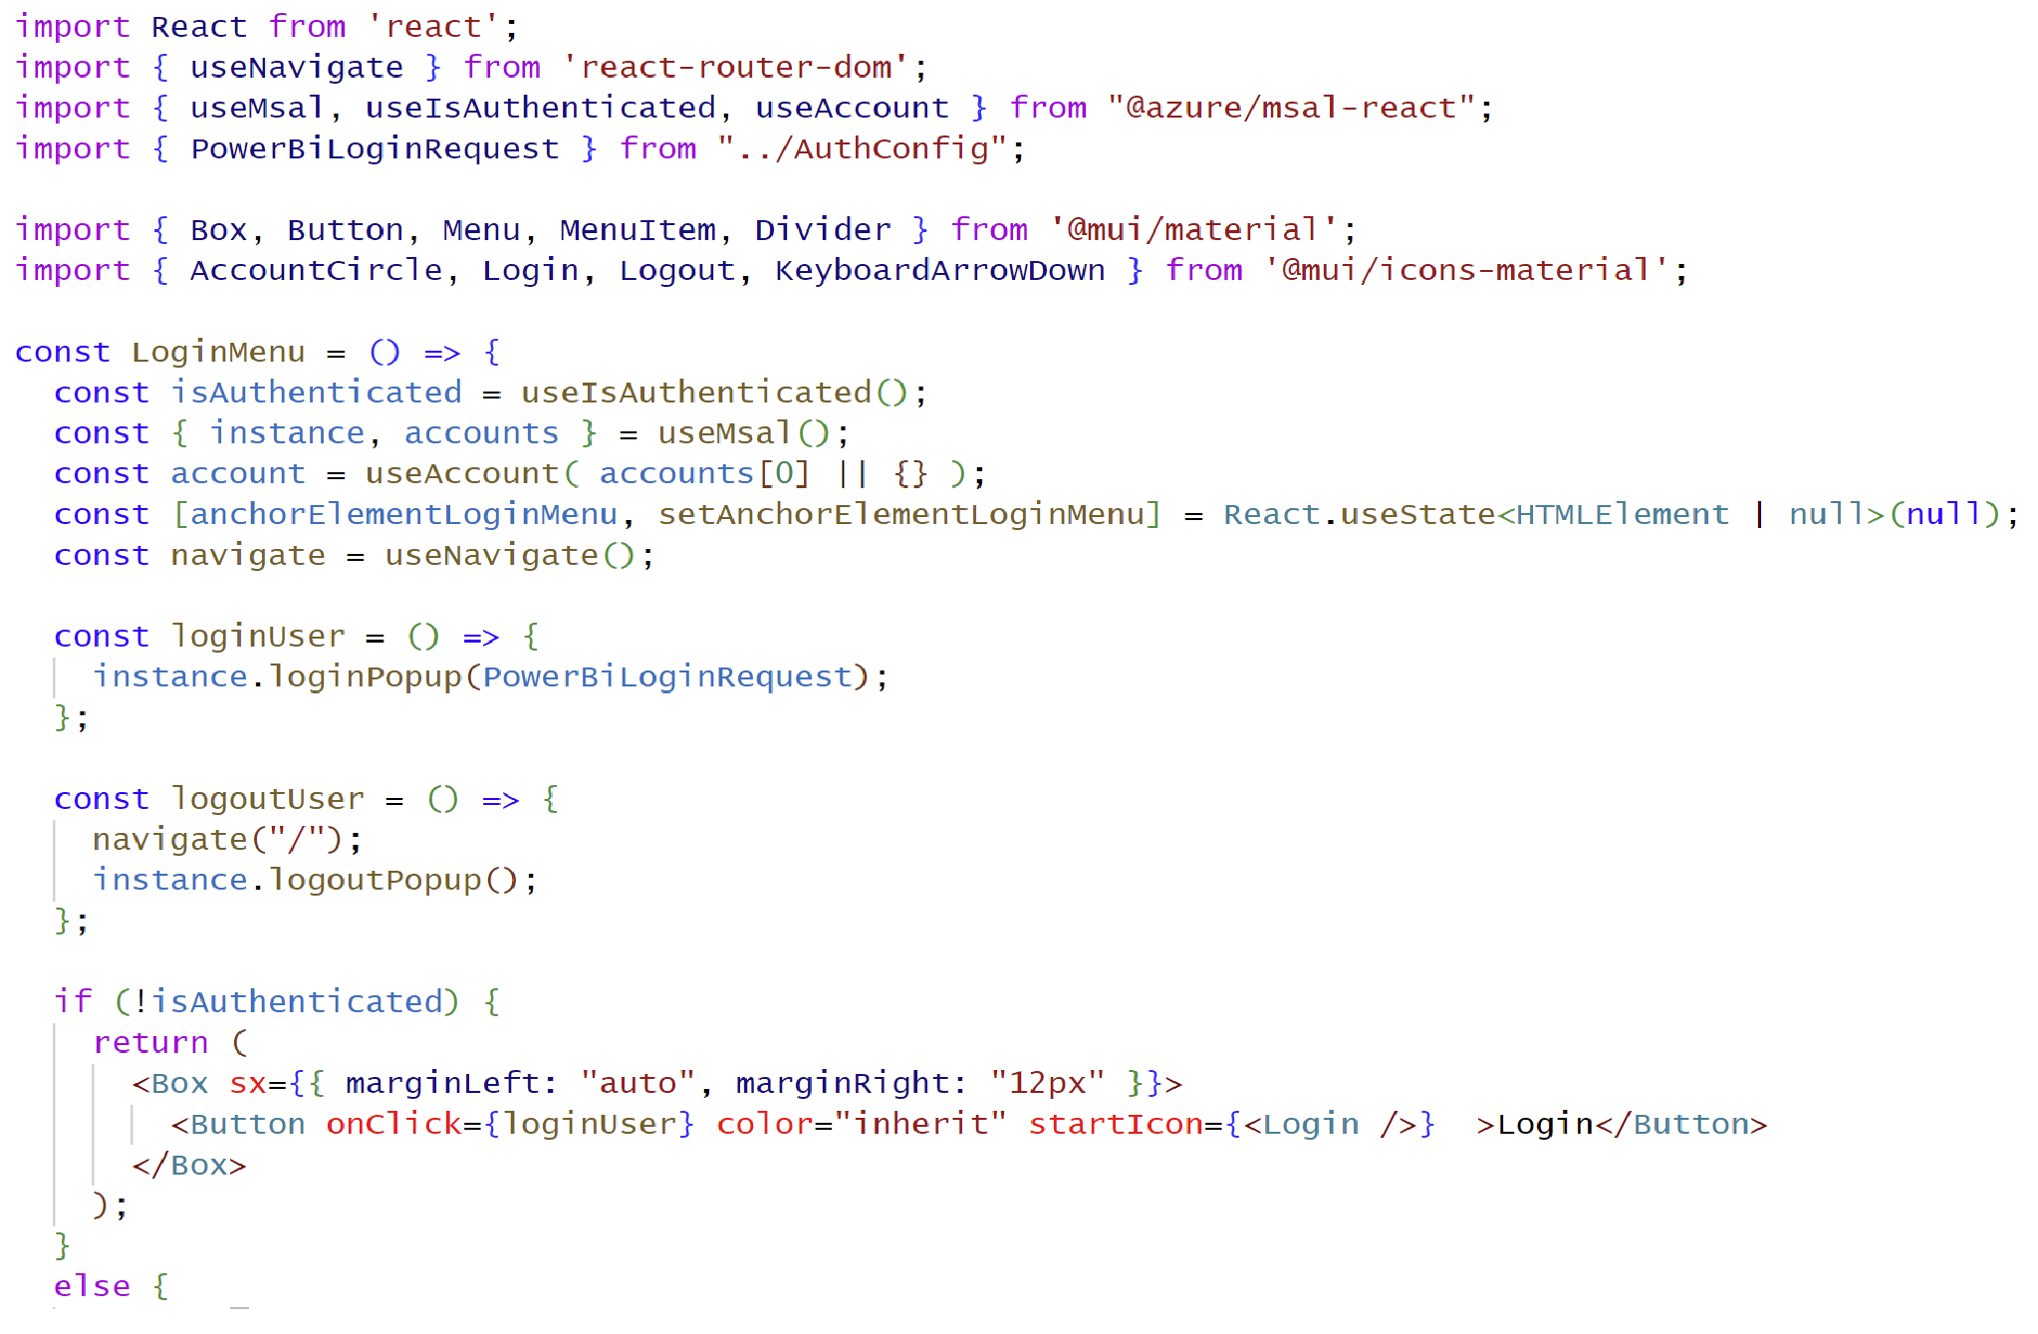
MSAL Component for React (@azure/msal-react)
msal-react designed with hooks
useMsal
useIsAuthenticated
useAccount

Slide 21
Initializing the MSAL Provider Instance in index.tsx

Slide 22
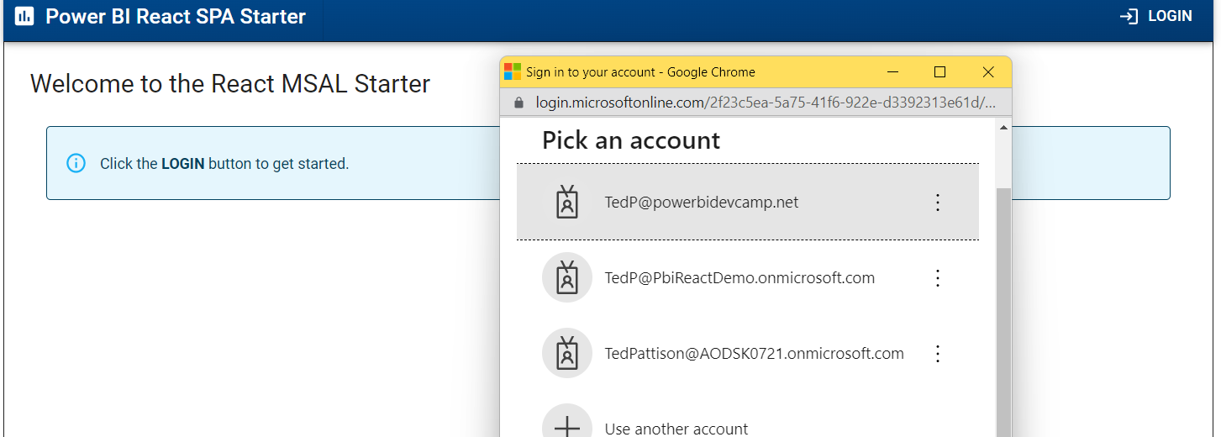
Login Behavior with LoginMenu.tsx

Slide 23
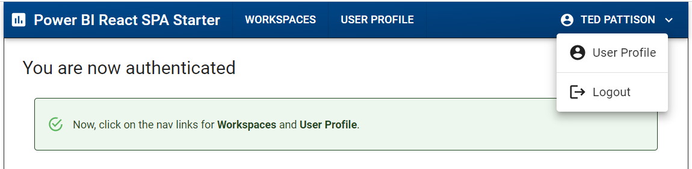
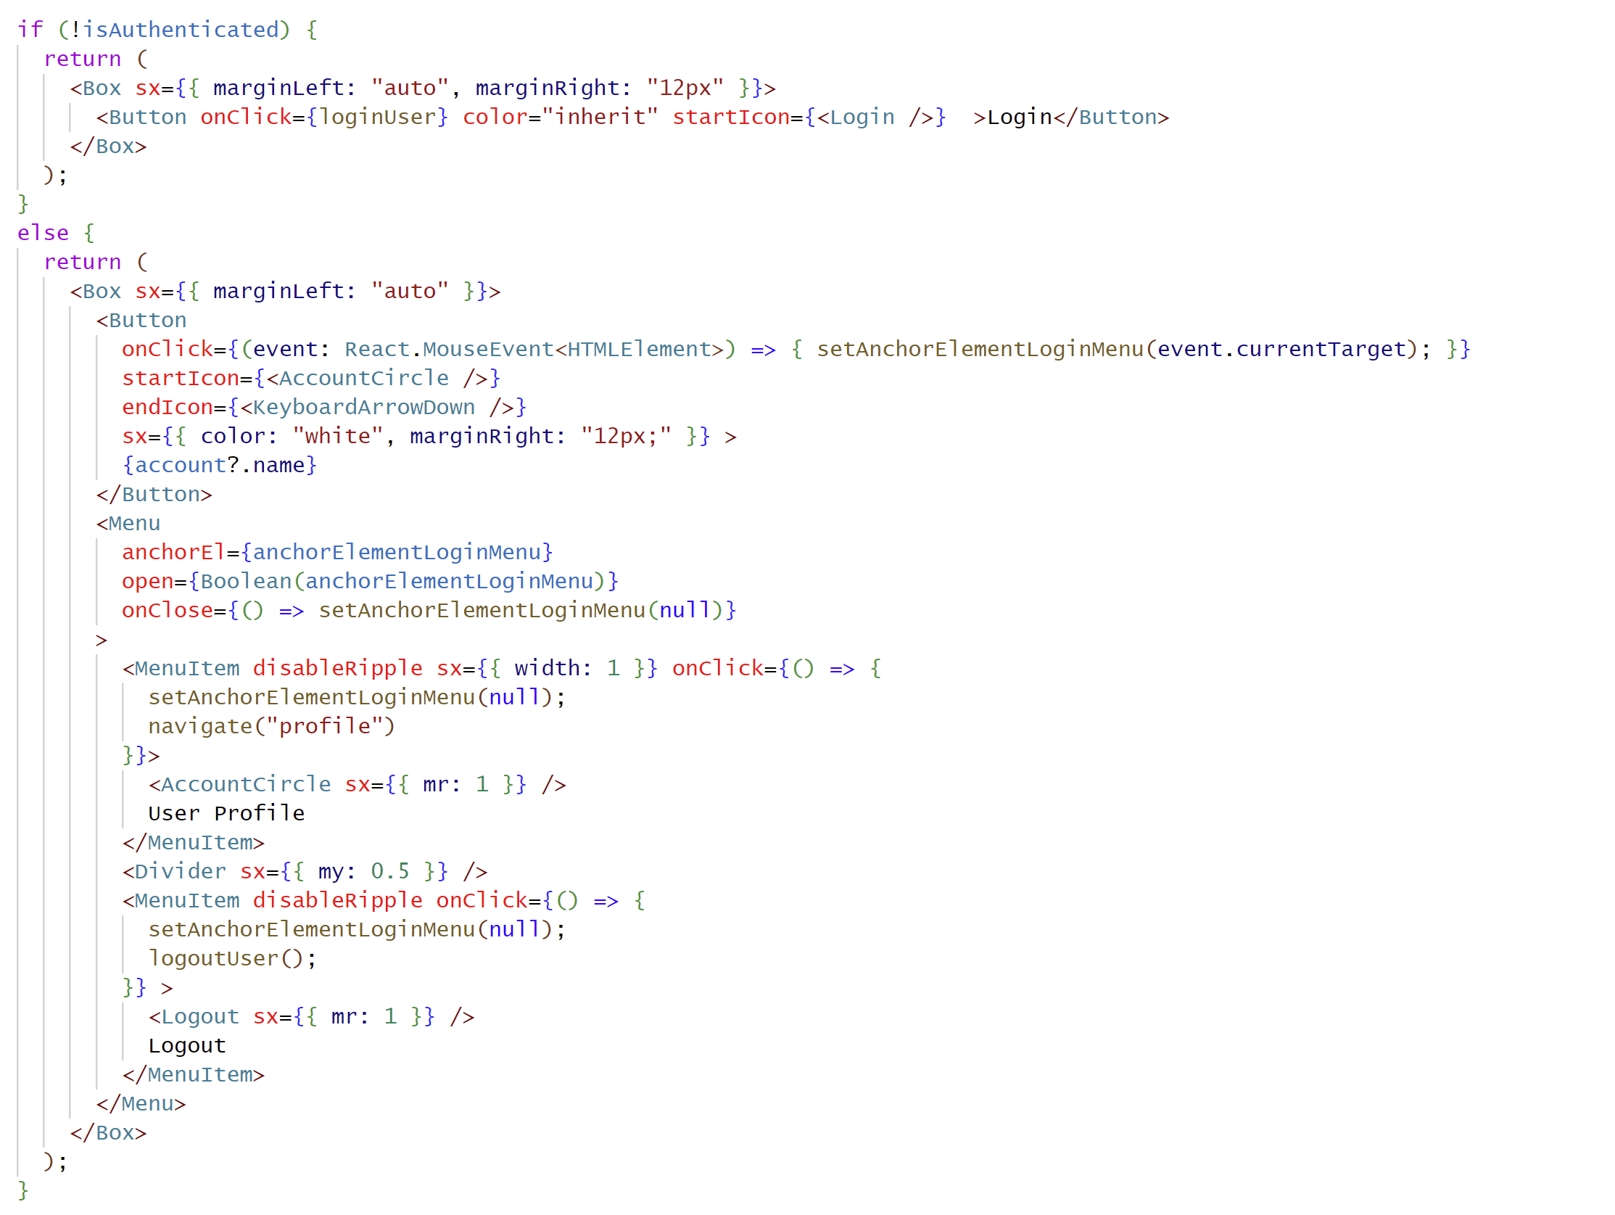
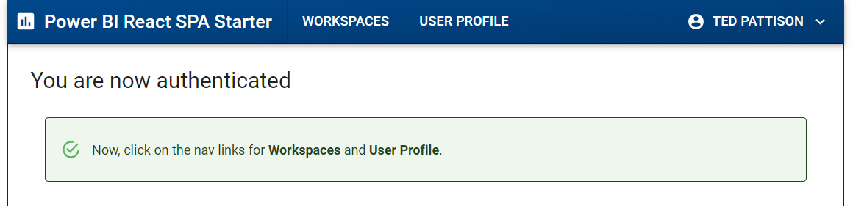
Logout Behavior with LoginMenu.tsx

Slide 24
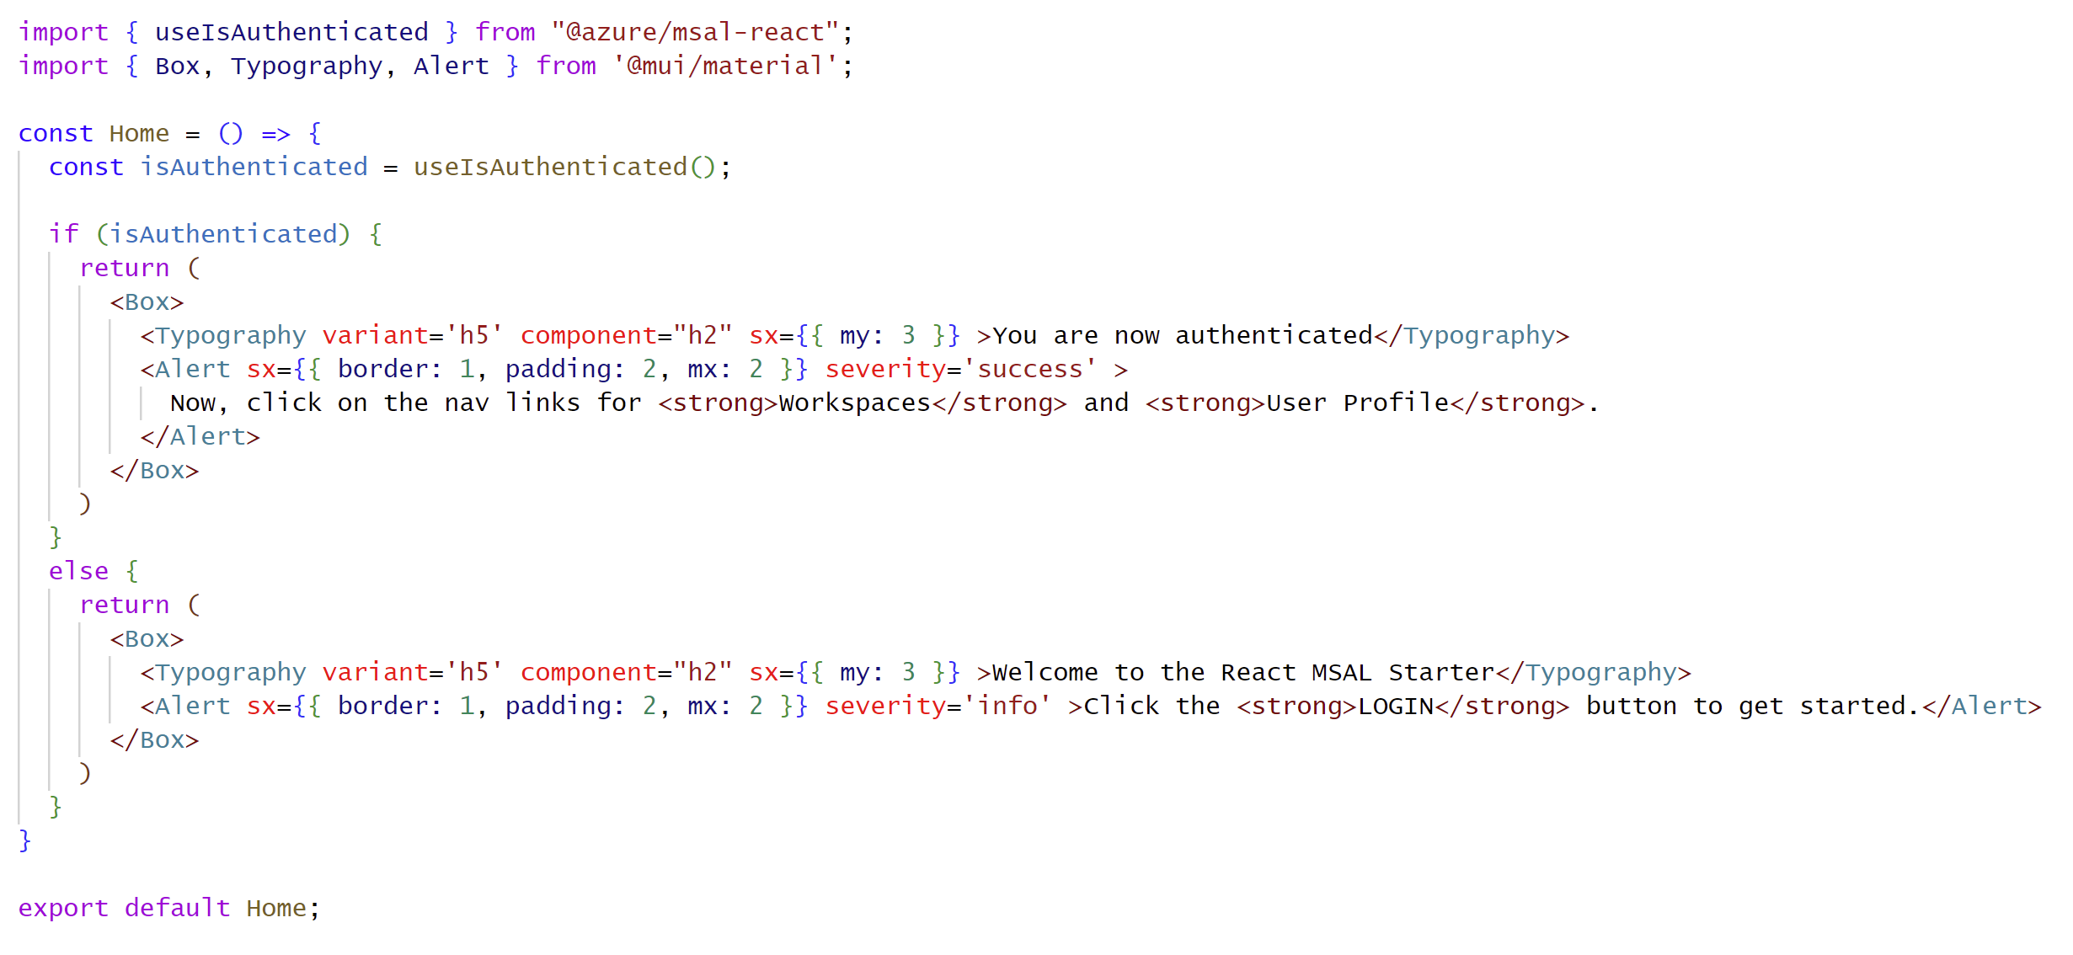
Checking Whether User Is Authenticated
Components use useIsAuthenticated hook to check if user is authenticated

Slide 25
Agenda
Modern React Primer
Building a User Interface using Material UI
Authenticating Users with MSAL
Calling the Power BI REST API
Managing Application State using Context
Implementing User-Owns-Data Embedding

Slide 26
Basics
Learn About Power BI REST API Operations
Creates Types for serialization
Get access token for current user using MSAL instance
Create class with helper methods to call API using fetch
Call helper methods from components using useEffect hook

Slide 27
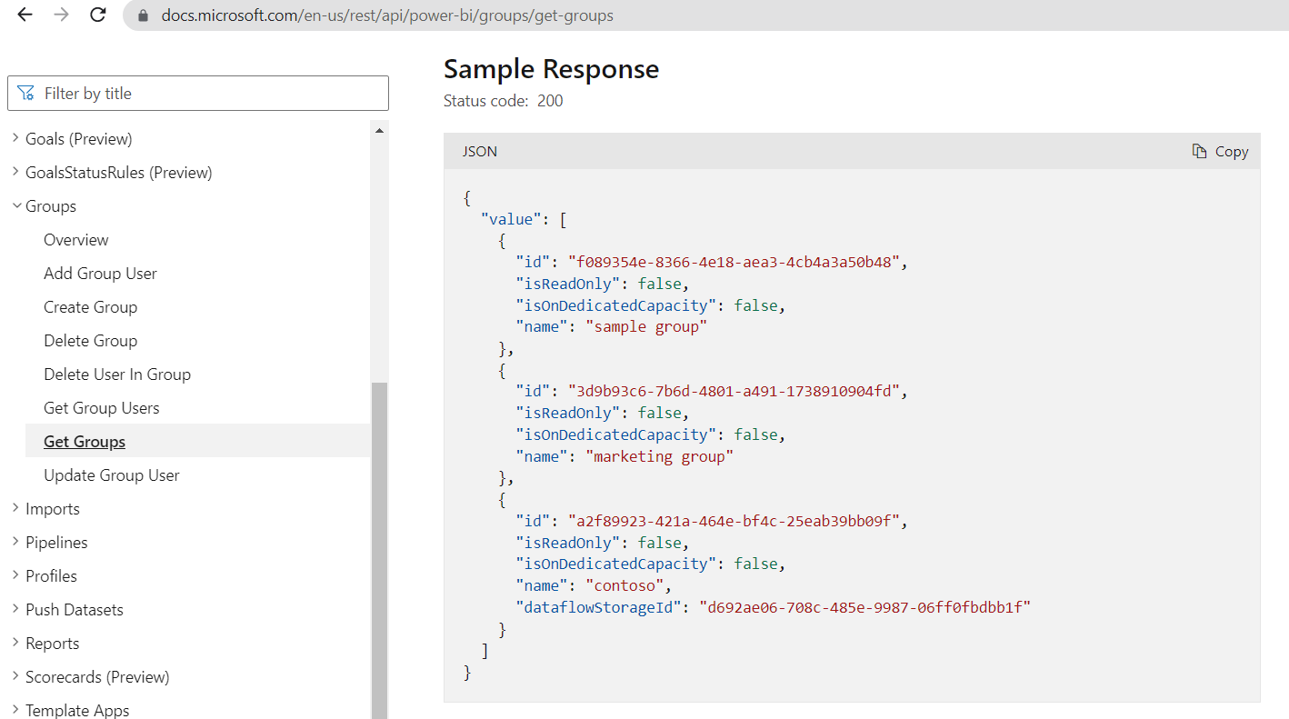
Learn About Power BI REST API Operations
Use documentation to learn about operations
https://docs.microsoft.com/en-us/rest/api/power-bi
Determine which delegated permissions are required

Slide 28
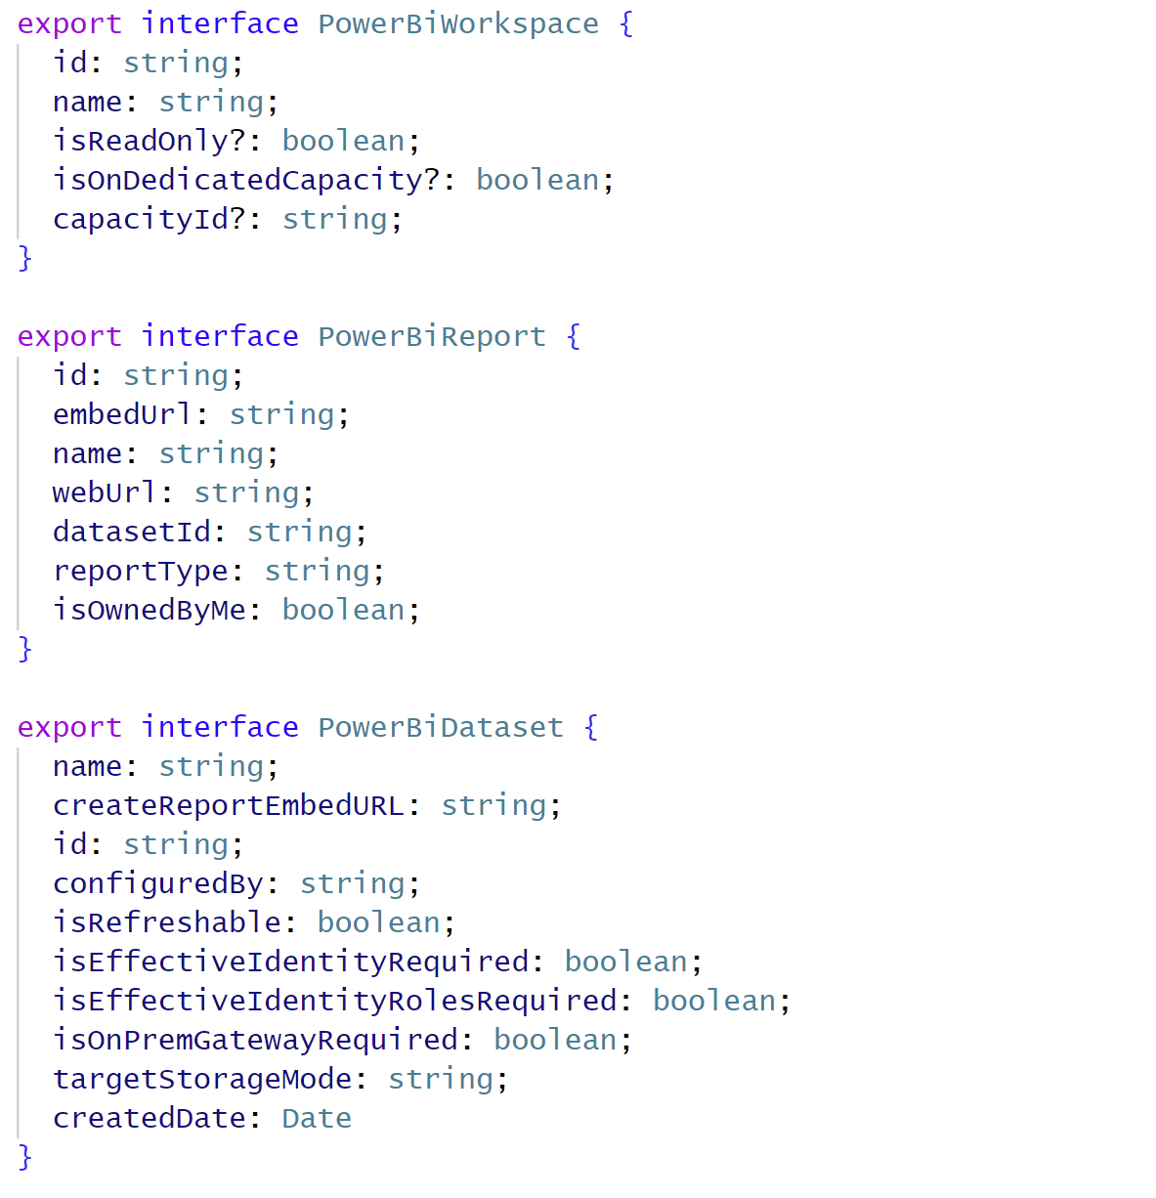
Defining Interface Serialization Types in PowerBiModels.ts

Slide 29
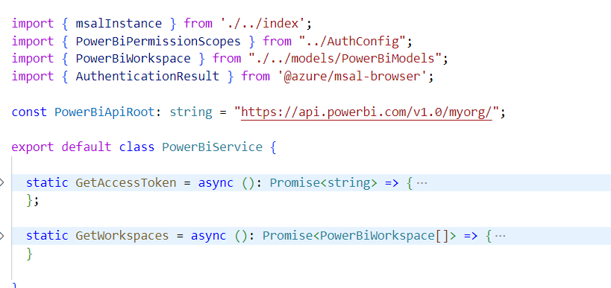
PowerBiService.ts
Provides static methods to get access token and call API operations

Slide 30
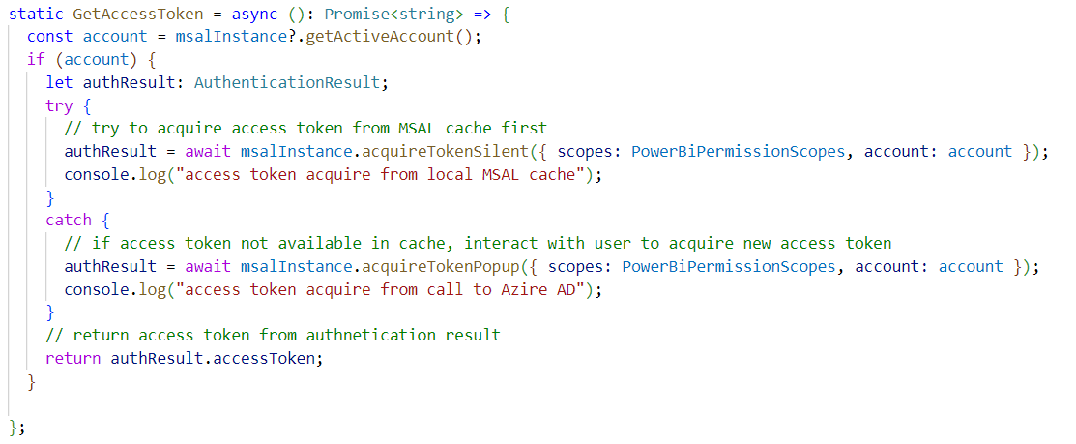
GetAccessToken

Slide 31
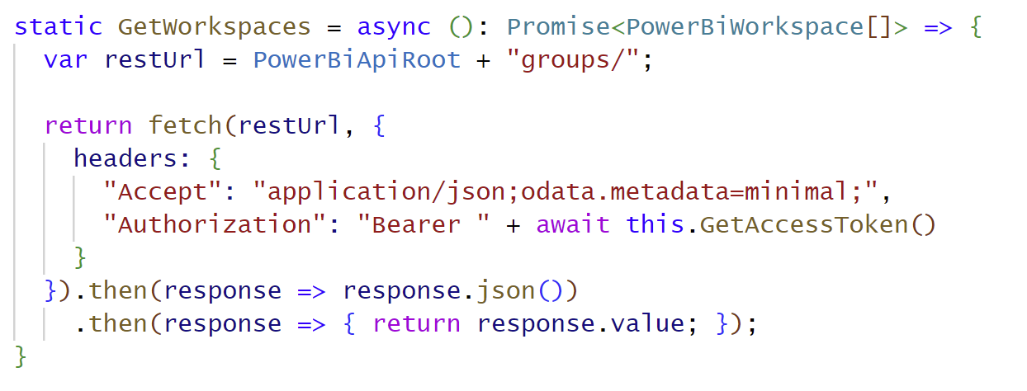
GetWorkspaces
Determine correct REST URL for API call
Call GetAccessToken to acquire access token
Add access token into Authorization header
Get JSON response and return to caller using serialization type

Slide 32
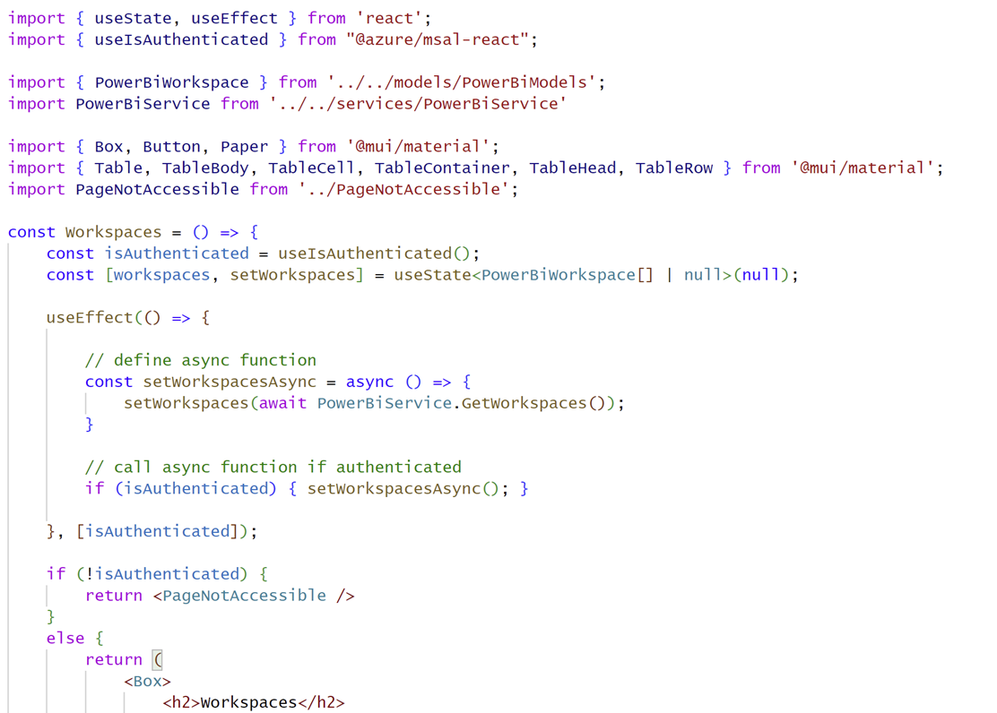
Calling GetWorkspaces from Workspaces.tsx
Calls across network should be made with useEffect hook
Function passed to useEffect cannot be asynchronous
Best practice is to define and call async method in function passed to useEffect
Update component state with results of API call to trigger component to re-render

Slide 33
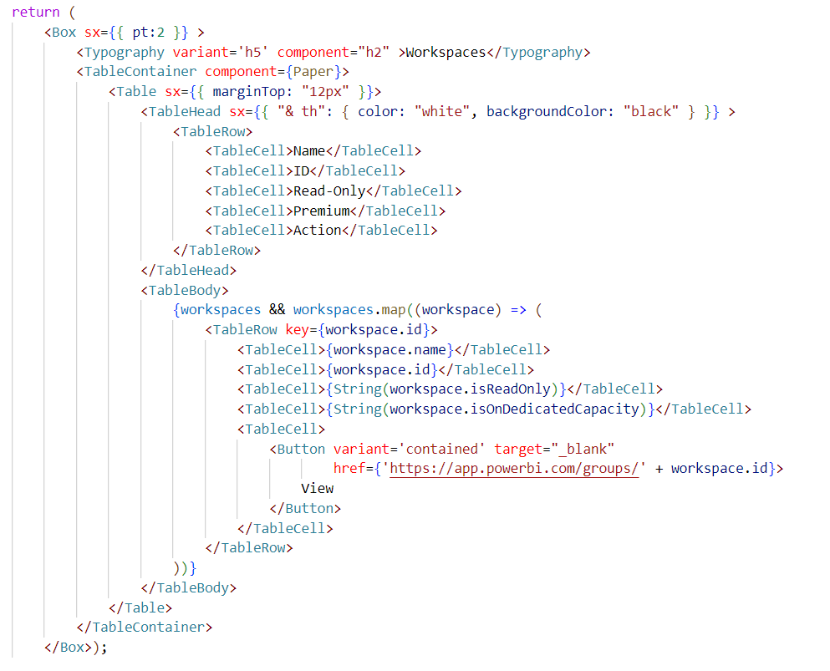
Rendering Workspaces in Workspaces.tsx

Slide 34
Agenda
Modern React Primer
Building a User Interface using Material UI
Authenticating Users with MSAL
Calling the Power BI REST API
Managing Application State using Context
Implementing User-Owns-Data Embedding

Slide 35
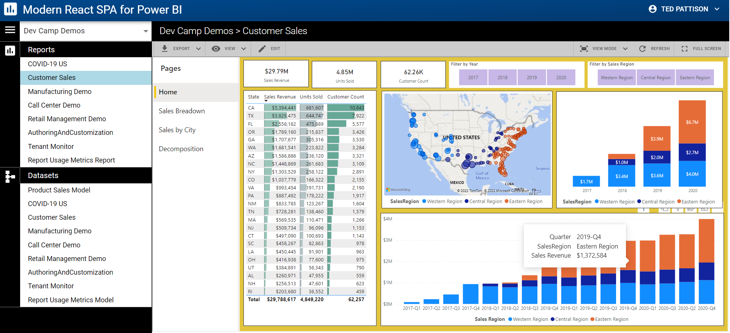
GitHub Repository: ModernReactForPowerBI
Demo code from this session available in public GitHub repository
https://github.com/PowerBiDevCamp/Modern-React-For-PowerBI

Slide 36
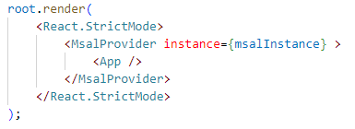
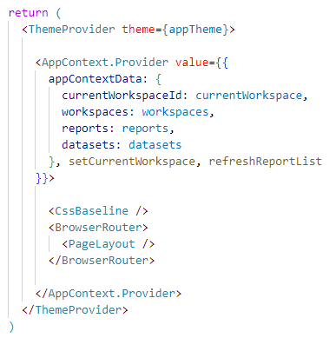
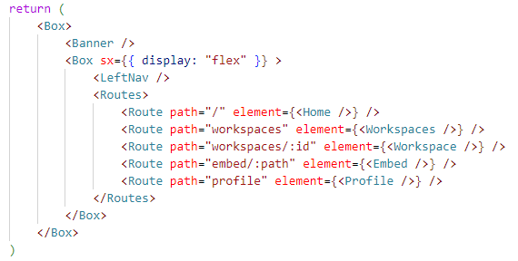
Top-level Component Hierarchy
Support for MSAL, Themes, React Router and a custom Application Context
index.tsc
app.tsc
pagelayout.tsc

Slide 37
Agenda
Modern React Primer
Building a User Interface using Material UI
Authenticating Users with MSAL
Calling the Power BI REST API
Managing Application State using Context
Implementing User-Owns-Data Embedding

Slide 38
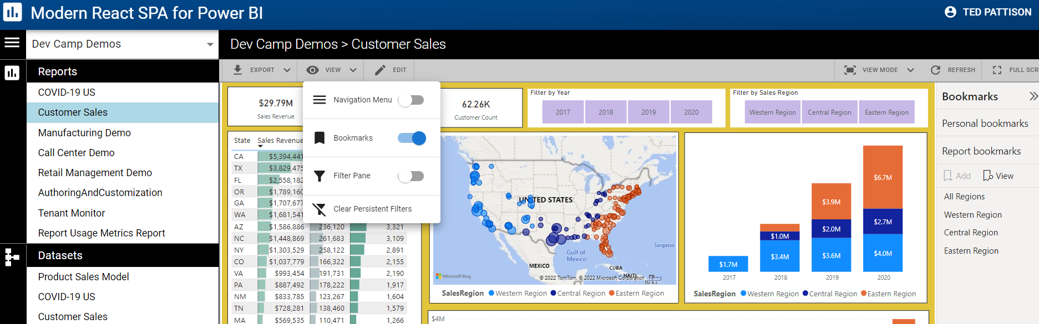
Demo of Modern React SPA for Power BI

Slide 39
Call to Action
Download and try out the samples
https://github.com/PowerBiDevCamp/Power-BI-React-SPA-Starter
https://github.com/PowerBiDevCamp/Modern-React-For-PowerBI
Learn more about modern React
https://beta.reactjs.org
Join Power BI Dev Camp Next Month for More React Coverage
Next month’s session covers modern REACT-JS development with App-Owns-Data embedding
https://aka.ms/devcamplive
Live and Love the Power BI Community
https://community.powerbi.com/

Slide 40
Microsoft Power BI
Questions?

